Slide 1
RAFI MFI Financial Products and Services

Slide 2


Slide 3
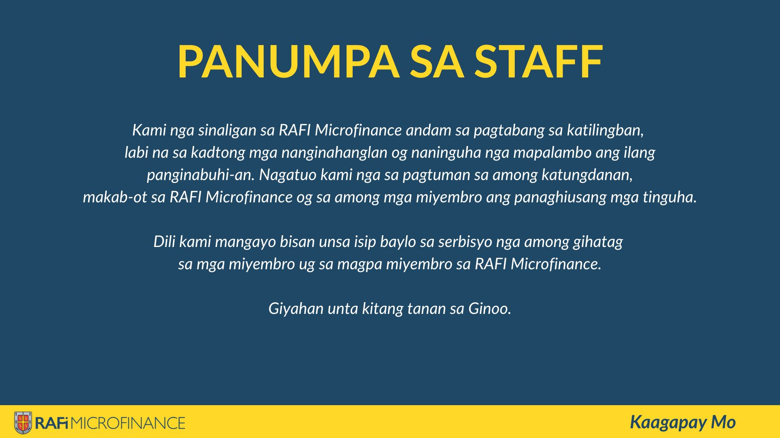

Slide 4
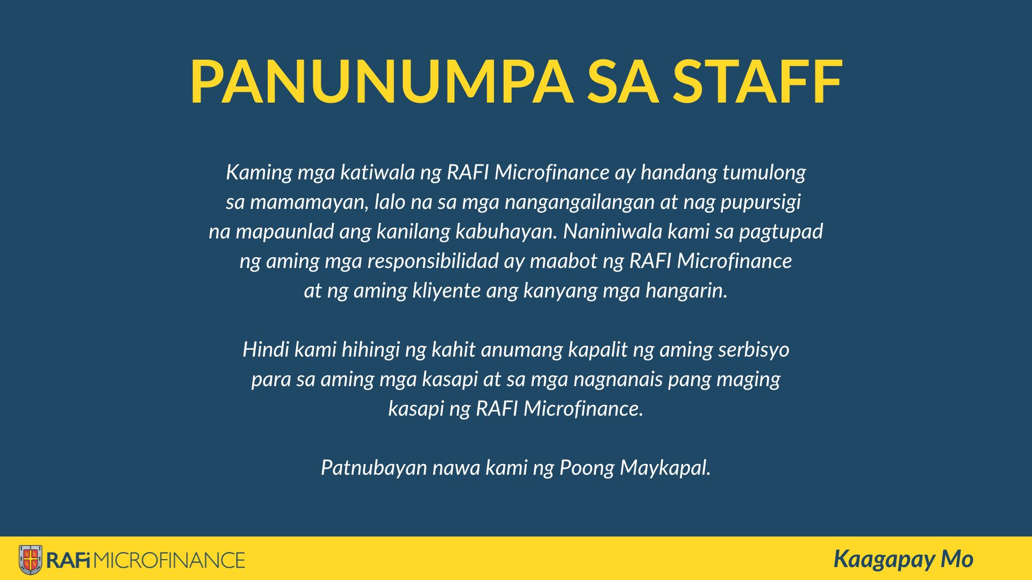

Slide 5


Slide 6


Slide 7
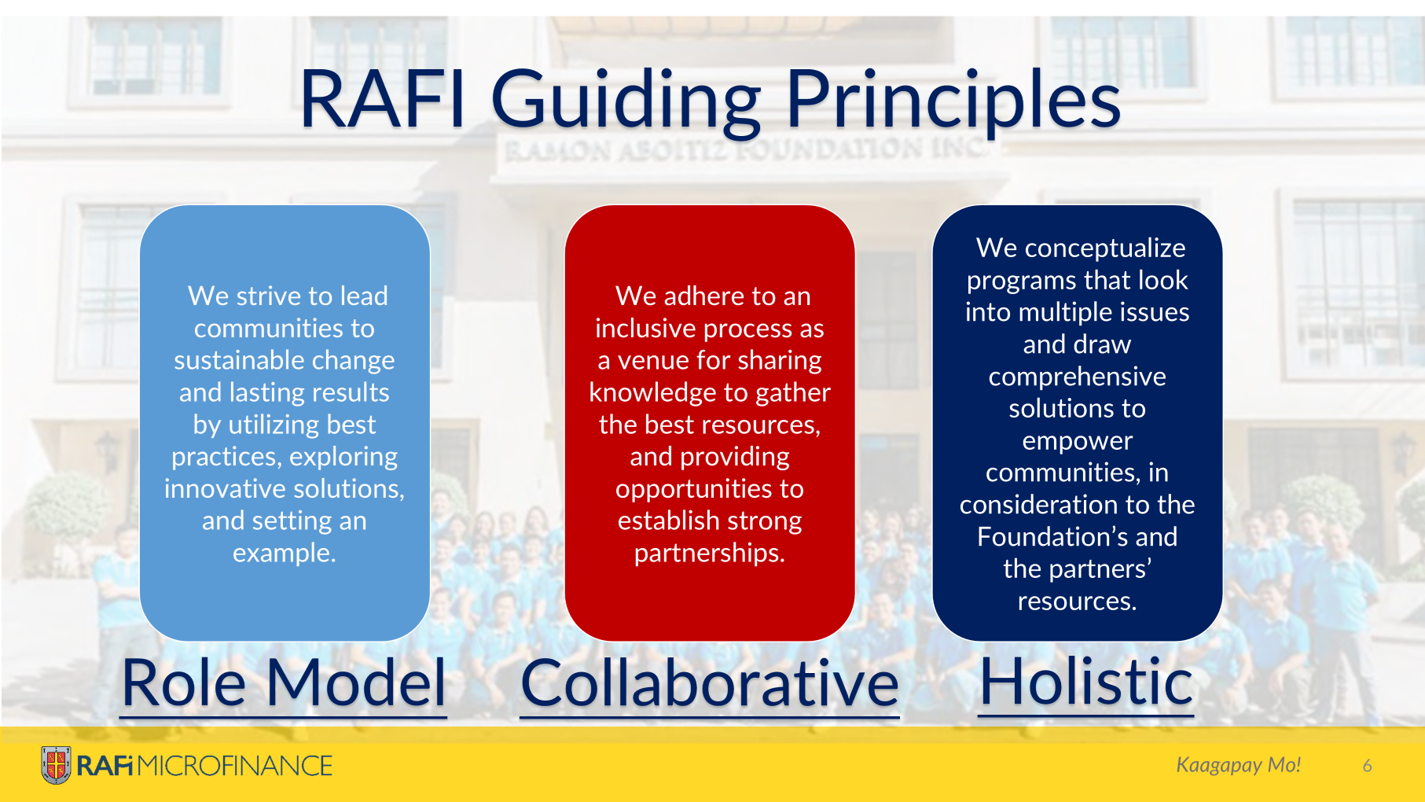
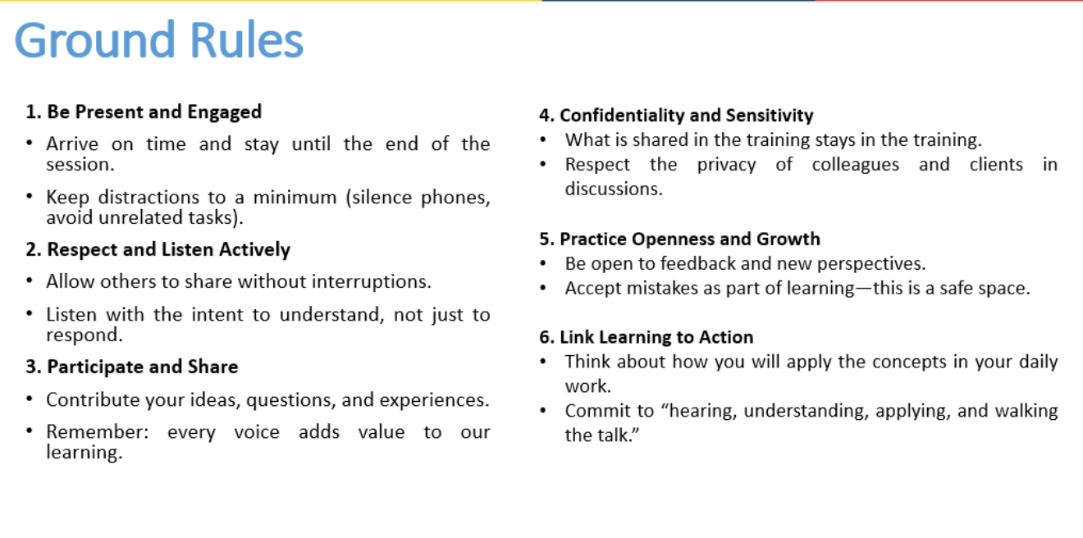

Slide 9

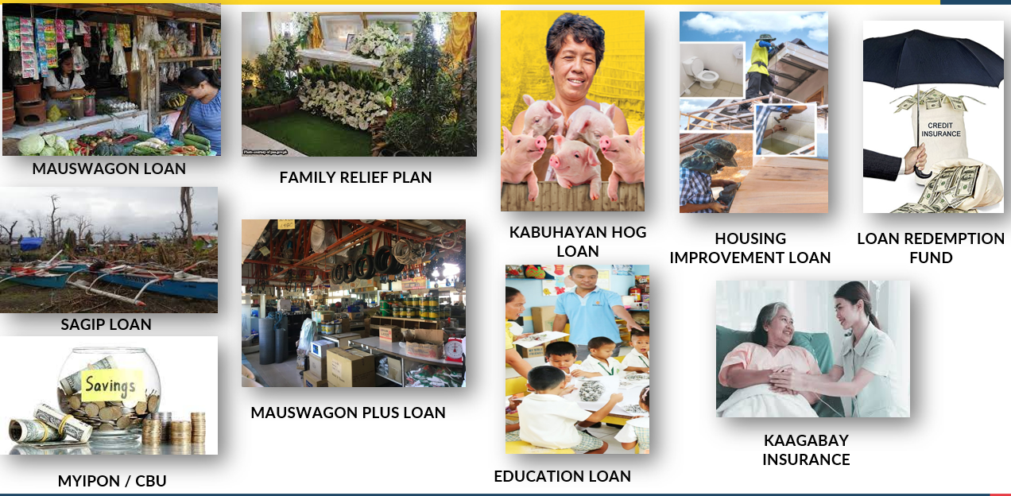
Notes:
PRODUCTION LOAN
-a loan used to furnish the business. It can be for working capital, additional capital, or capital expenditure.
SUPPLEMENTAL LOAN
-is offered by RAFI MFI for the client’s purposes either for household improvements and/or education expenses.
-this is also considered to be personal or consumption loans
MICROINSURANCE
-An ancillary and mandatory micro insurance product that provides comprehensive financial protection for the family in case of accidental injuries and death.
MICROSAVINGS
-Republic Act (RA) No. 10693 or the Microfinance NGO Act defines micro-savings as the “program to collect small amounts of money from the members to maintain a compensating balance”.
The RAFI MFI Capital Build Up (CBU) aims to foster self-reliance and encourage the habits of saving among the members. This is primarily to build equity for their entrepreneurial endeavors and establish reserves for their bridge financing needs.

Slide 10
RAFI MFI Financial Products and Services
Production Loan
Supplemental Loan
SAGIP Loan as Disaster Recovery
Microinsurance
Kabuhayan Hog
Education Loan
SAGIP Loan as Emergency
Loan Redemption Fund
Microsavings
MyIpon
Mauswagon Loan
Housing Improvement Loan
CBU
Family Relief Plan
Kaagabay (GPA)
Notes:
PRODUCTION LOAN
-a loan used to furnish the business. It can be for working capital, additional capital, or capital expenditure.
SUPPLEMENTAL LOAN
-is offered by RAFI MFI for the client’s purposes either for household improvements and/or education expenses.
-this is also considered to be personal or consumption loans
MICROINSURANCE
-An ancillary and mandatory micro insurance product that provides comprehensive financial protection for the family in case of accidental injuries and death.
MICROSAVINGS
-Republic Act (RA) No. 10693 or the Microfinance NGO Act defines micro-savings as the “program to collect small amounts of money from the members to maintain a compensating balance”.
The RAFI MFI Capital Build Up (CBU) aims to foster self-reliance and encourage the habits of saving among the members. This is primarily to build equity for their entrepreneurial endeavors and establish reserves for their bridge financing needs.

Slide 11


Mauswagon Loan
**new and consolidated
Intended to provide better, flexible and family- oriented cash flow based financial services, from start- up business to micro enterprises, with PPI score 25 to 75 for the following purposes:
Notes:
This loan is available to all clients across RAFI MFI who meet the required qualifications mauswagon loan. This is also our main product
MAUSWAGON LOAN PURPOSE
M – Additional Capital/Working Capital – Operating Expenses
M – Purchase/Rent of business equipment
M – Manpower expenses, fuel/gas expenses
M – Purchase of raw materials such as fertilizer, seeds or seedling, feeds, livestock, goods for sale
M- Repairs and maintenance, construction/improvement of livestock/poultry pen/business shop/outlet
M – Purchase of digital/technology tools

Slide 12

Product Features
Loan Amount
5,000.00 to 50,000.00
Loan Term
3, 6 and 9 months (18 months for existing clients with loans amounting to P20,000 to 50,000)
Micro-Insurance Product Bundle
Kaagabay Insurance*​ Family Relief Plan**​ Loan Redemption Fund*​ ** for RL accounts only​ * applicable to all active borrowers​
Repayment Frequency
Weekly Fortnightly
Service Charge
Membership Fee
For new clients only
✓ Php 50.00 membership fee is required upon first loan release,
1% of the loan amount
Early Payment Reward
Interest
ü6.48% per month, diminishing (3.33% per month, flat)
ü4.92724% per month, diminishing (2.5% per month, flat) for Loan Cycles 3 and above
All Production Loans, new and reloans
ZERO late payments in the current loan
Must reloan at the same amount or higher
Early full payment of the current loan
Must reloan immediately
Notes:
What are the changes? Mauswagon Loyalty Pricing to: MAUSWAGON LOYALTY DISCOUNT
with eligibility criteria of:
1. Must be at loan cycle of 3 and above.
2. Zero late repayments in the previous loan.
3. Must reloan at the same amount or higher than the previous loan.
Documentary Requirements
New Loans
Duly filled out Loan Application Form, with signature of spouse, if married.
1 pc 1x1 picture for RAFI MFI ID​
Valid ID or Barangay Clearance (in the absence of Valid IDs)​
Valid ID of Spouse
Repeat Loans
Duly filled out Loan Application Form, with signature of spouse, if married.
(If IDs and other documents are still valid with the same comaker)

Slide 13
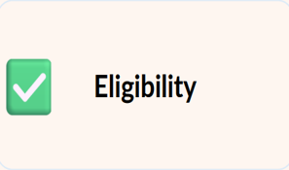
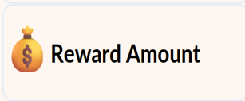
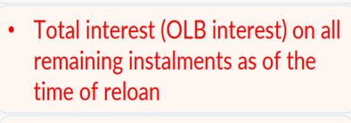
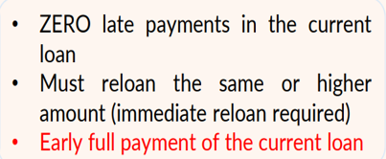
EARLY PAYMENT REWARD
The early payment reward will be credited to the client’s savings upon loan release.​
​
Notes:
Note : The early payment reward will be credited to the client’s savings upon loan release

Slide 14
Eligibility Criteria
NEW CLIENT
EXISTING CLIENT
Must be 18-75 years’ old
Must have 100% repayment from the previous loan
Must be a member of Group Center with at least 80% attendance
Must pass the LSV
Must be 18-64 years’ old
Must have a business
Must be a resident of at least 1 year on present address with no plans of transfer within the next 2 years
Notes:
NEW CLIENTS
Must pass the background and credit investigation
Must agree to loan size proportionate to payment capacity
Must have other source of family income either daily/weekly/monthly
Must have no active legal case(s)
Must be physically fit and mentally sound
Must have no other household members that are members of RAFI MFI
EXISTING CLIENT
Must be a resident of at least 1 year on present address with no plans of transfer within the next 2 years
Must agree to loan size proportionate to payment capacity
Must have other source of family income either daily/weekly/monthly
Must have no active legal case(s)
Must be physically fit and mentally sound
Must have no other household members that are members of RAFI MFI.

Slide 15


Kabuhayan Hog Loan
A special loan for hog raisers offered to new and existing clients with PPI score of 25 to 75, engaged in hog raising business with at least 5 hogs
Note: Loan purposes for poultry (e.g., chickens) or any non–hog-raising purposes are NOT allowed.
Notes:
KABUHAYAN HOG LOAN PURPOSE
KL - Construction /improvement of livestock pen
KL - Purchase of feeds
KL - Purchase of livestock heads

Slide 16








Product Features
 | Loan Amount
 | P15,000-P150,000
 | Loan Term
 | 5 months
 | Repayment Frequency
 | Weekly (interest) Lump sum (principal)
 | Interest
 | 3% per month, based on diminishing​ rate
 | Service Charge
 | 0%
 | Micro-Insurance Product Bundle
 | Kaagabay Insurance*​ Family Relief Plan**​ Loan Redemption Fund*​ ** for RL accounts only​ * applicable to all active borrowers​
Loan Capping per Branch
10% loan cap for Kabuhayan Hog Loan releases against the total branch loan portfolio
Membership Fee
For new clients only
✓Php 50.00 membership fee
Notes:
Clients that avail Kabuhayan Hog loan can also avail the early payment reward
Documentary Requirements
New Loans
1 pc 1x1 picture for RAFI MFI ID​
Valid ID or Barangay Clearance (in the absence of Valid IDs)​
Valid ID of Spouse
Eligibility Criteria
NEW LOANS
•Must be 18-60 years’ old
•Must have existing hog raising or fattening business with at least 5 hogs
•Must be a resident of at least 1 year on present address with no plans of transfer within the next 2 years
•Must agree to loan size proportionate to payment capacity
•Must have other source of family income either daily/weekly/monthly
•Must have no active legal case(s)
•Must pass the background and credit investigation
•Must be physically fit and mentally sound
•Must have no other household members that are members of RAFI MFI
•Must have the capacity to manage a business or is business minded
•With good credit standing
•Must be able to attend regular center meetings
•Must be disciplined and responsible
RELOAN
•Must be 18-75 years’ old
•Must have existing hog raising or fattening business with at least 5 hogs
•Must have 100% repayment from the previous loan
•Must be a member of Group Center with at least 80% attendance
•Must have other source of family income either daily/weekly/monthly
•Must have no active legal case(s)
•Must agree to loan size proportionate to payment capacity
•Must pass the LSV
•Must be physically fit and mentally sound
Note: The client must have 100% repayment from the previous loan. All outstanding balances from KL must be completely settled prior to processing the reloan application. Additionally, pre-deduction of OLB from the reloan is strictly prohibited.

Slide 17
RAFI MFI Financial Products and Services
Production Loan
Supplemental Loan
SAGIP Loan as Disaster Recovery
Microinsurance
Kabuhayan Hog
Education Loan
SAGIP Loan as Emergency
Loan Redemption Fund
Microsavings
MyIpon
Mauswagon Loan
Housing Improvement Loan
CBU
Family Relief Plan
Kaagabay (GPA)
Notes:
SUPPLEMENTAL LOAN
-is offered by RAFI MFI for the client’s purposes either for household improvements and/or education expenses.
-this is also considered to be personal or consumption loans

Slide 18
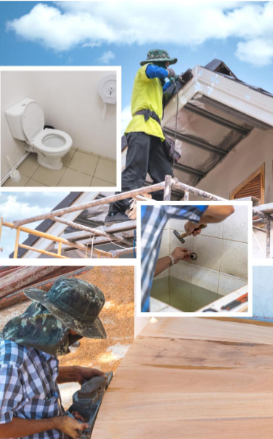

Housing Improvement Loan
This supplemental loan aims to assists members, and their families have a comfortable living through house improvement and dignified access to safe water and sanitary toilet facilities. The loan purpose is to support either one of the following
•HIL – Housing improvement
•HIL - WASH Water
•HIL – WASH Sanitation & Hygiene
•HIL – Green Microfinance

Slide 19
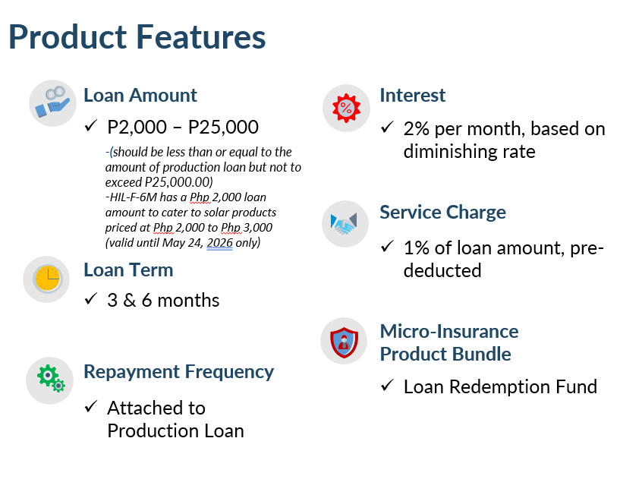
Housing Improvement Loan
This supplemental loan aims to assists members, and their families have a comfortable living through house improvement and dignified access to safe water and sanitary toilet facilities. The loan purpose is to support either one of the following:

Slide 20
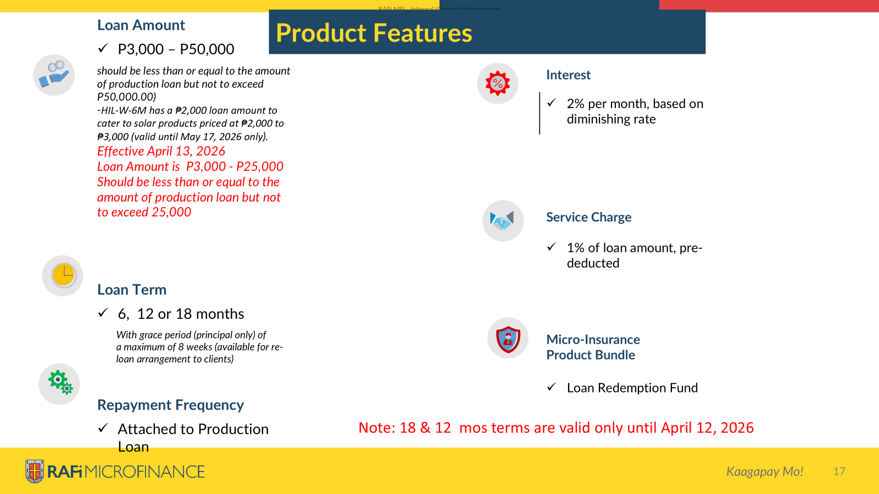
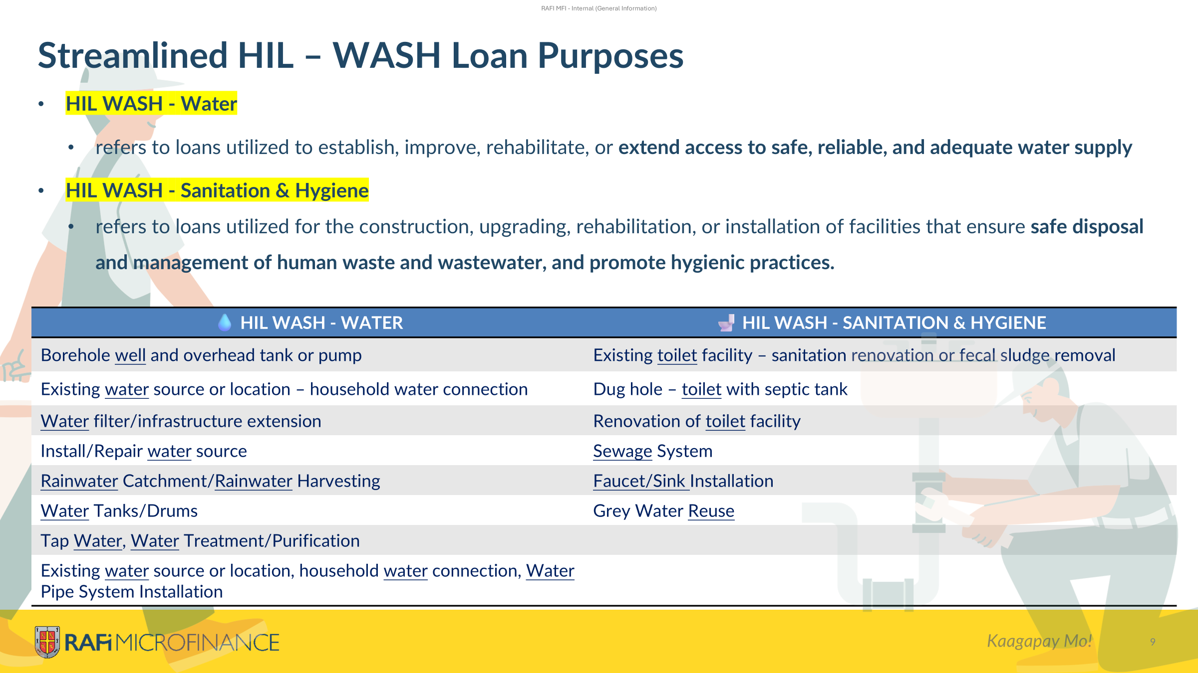
 | Loan Amount
 | P3,000 – P50,000 should be less than or equal to the amount of production loan but not to exceed P50,000.00) -HIL-W-6M has a ₱2,000 loan amount to cater to solar products priced at ₱2,000 to ₱3,000 (valid until May 17, 2026 only).
 | Loan Term
 | 6, 12 or 18 months​ With grace period (principal only) of a maximum of 8 weeks (available for re-loan arrangement to clients)
 | Repayment Frequency
 | Attached to Production Loan
Product Features
 | Interest
 | 2% per month, based on diminishing rate
 | Service Charge
 | 1% of loan amount, pre-deducted
 | Micro-Insurance Product Bundle
 | Loan Redemption Fund
Notes:
ELIGIBILITY CRITERIA
At least two (2) production loan cycles
An active production loan. In other words, the borrower may avail of the HIL in his/her 3rd production loan cycle
Sufficient cash flow to cover the amount applied
Maintained 80% of the payments on time and in accordance with the required amortization due for both the previous and current production loan. In other words, 80% "no missed payment".
Fully paid off (100%) the previous production loan
An existing house/water/toilet facility structure
Attached photo of the house or part of the house to be repaired or improved that should fit the sub purpose of the loan applied for**
Bill of materials needed for house improvement (loan proposal)
Documentary Requirements
. Upload in the system the photo of the house or part of the house to be repaired or improved that should fit the sub purpose of the loan applied for**
Upload Bill of materials needed for house improvement ( loan proposal )

Slide 21
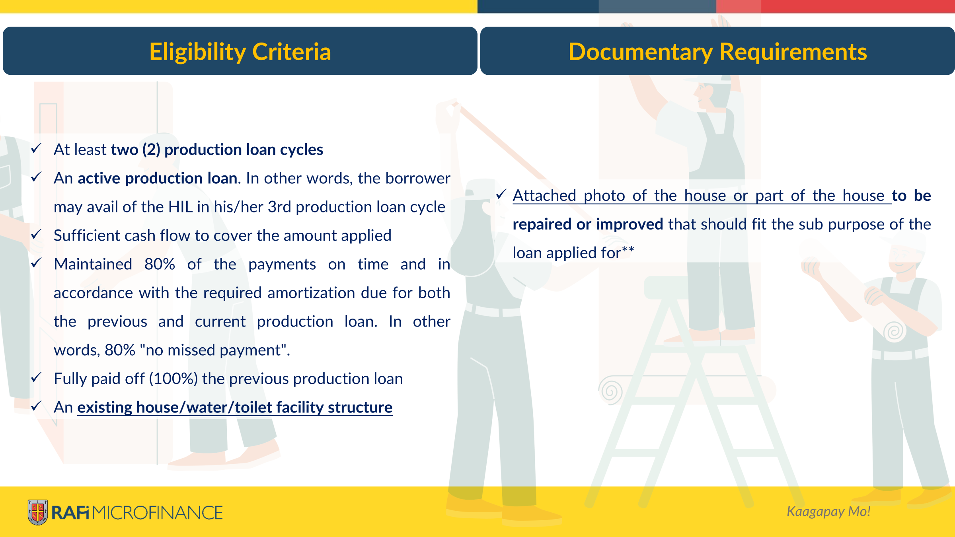
 | Loan Amount
 | P3,000 – P50,000 should be less than or equal to the amount of production loan but not to exceed P50,000.00) -HIL-W-6M has a ₱2,000 loan amount to cater to solar products priced at ₱2,000 to ₱3,000 (valid until May 17, 2026 only).
 | Loan Term
 | 6, 12 or 18 months​ With grace period (principal only) of a maximum of 8 weeks (available for re-loan arrangement to clients)
 | Repayment Frequency
 | Attached to Production Loan
Product Features
 | Interest
 | 2% per month, based on diminishing rate
 | Service Charge
 | 1% of loan amount, pre-deducted
 | Micro-Insurance Product Bundle
 | Loan Redemption Fund
Notes:
ELIGIBILITY CRITERIA
At least two (2) production loan cycles
An active production loan. In other words, the borrower may avail of the HIL in his/her 3rd production loan cycle
Sufficient cash flow to cover the amount applied
Maintained 80% of the payments on time and in accordance with the required amortization due for both the previous and current production loan. In other words, 80% "no missed payment".
Fully paid off (100%) the previous production loan
An existing house/water/toilet facility structure
Attached photo of the house or part of the house to be repaired or improved that should fit the sub purpose of the loan applied for**
Bill of materials needed for house improvement (loan proposal)
Documentary Requirements
. Upload in the system the photo of the house or part of the house to be repaired or improved that should fit the sub purpose of the loan applied for**
Upload Bill of materials needed for house improvement ( loan proposal )

Slide 22


Education Loan
Loan Product ensures academic success by providing financial support for tuition, fees, textbooks, school supplies, and technology. We support students, including those preparing for licensure exams, and empower students not eligible for the Bugsay Scholarship Program of RAFI MFI. This ensures that clients and/or their children can attend school, whether in person or through virtual and/or distance learning and successfully complete their education utilizing the following sub-purposes:​
Loan Product ensures academic success by providing financial support for tuition, fees, textbooks, school supplies, and technology. We support students, including those preparing for licensure exams, and empower students not eligible for the Bugsay Scholarship Program of RAFI MFI. This ensures that clients and/or their children can attend school, whether in person or through virtual and/or distance learning and successfully complete their education utilizing the following sub-purposes:​
EL - Other Fees | EL – Tuition
EL - School Supplies | EL – Uniform
EL - Tech2Educate | EL – Licensure exam/requirements/fees
EL - Other Fees | EL – Tuition
EL - School Supplies | EL – Uniform
EL - Tech2Educate | EL – Licensure exam/requirements/fees

Slide 23





Product Features
 | Loan Amount
 | P2,000 – P30,000 (should be less than or equal to the amount of production loan but not to exceed P30,000.00)
 | Loan Term
 | 6 or 9 months​ (with grace period (principal only) of maximum of 8 weeks)
 | Repayment Frequency
 | Attached to Production Loan
 | Minimum CBU Requirement
 | 20% of the loan amount
 | Min. CBU Contribution Requirement
 | P50 for weekly, P375 for bi-monthly and P750 for monthly repayment frequencies​
 | Mode of Payment
 | Cash
 | Interest
 | 2% per month, based on diminishing rate
 | Service Charge
 | 1% of loan amount, pre-deducted
 | Micro-Insurance Product Bundle
 | Loan Redemption Fund
 | Validity Branches
 | All RAFI MFI branches, regardless of branch age, provided branch does not exceed acceptable branch PAR level and supplemental loan capping​​
Notes:
Eligibility Criteria for Housing Improvement Loan:
1. •Must have at least two (2) production loan cycles
•Must have an outstanding Production Loan
•Must have a sufficient cash flow to cover the applied loan amount
•Must have maintained 100% repayment of the previous and current production loan
•Have at least one (1) child (below 21 years old) who is attending school
•He/she has no kids below 21 years old but is wanting to take the licensure exam
•Client or their children who are planning to take the licensure exam
Client or their children is studying or teacher
Documentary Requiements
•Attached enrollment slip or any proof (such as study load or school ID that shows the current school year) that the applicant’s child is going to school and at a specific level (i.e., elementary, high school, or college)**
•For Tech2Educate - Brochure or picture of the gadget that client intends to buy (must have visible price and/or price quotation included)**
•For licensure exam takers – Copy of diploma, quotation from review centers and quotation of licensure exam fee**

Slide 24

SAGIP Loan as Emergency
(Social Assistance Geared for Indigent People Loan)
This is a supplemental loan product designed to provide immediate cash funds to RAFI MFI clients during an emergency such as health/medical concerns, cash flow needs due to seasonal income, calamity/disaster-related expenditures.
SL – Hospital/medical fees SL - Purchase of medicines SL – Additional Capital SL – Business Re-capitalization SL- Facilities Remediation

Slide 25

Product Features
 | Loan Amount
 | P2,000-P10,000
 | Maximum loanable amount should be X3 of CBU withdrawable balance, whichever is lower, provided that it shall not exceed the current production loan.
 | Loan Term
 | 6 months ​With grace period (principal only) of a maximum of 8 weeks
 | Repayment Frequency
 | Depend on the payment frequency of the production loan availed.
Interest
2% per month based on the diminishing rate
Service Charge
1% of loan amount, pre-deducted
Micro-Insurance Product Bundle
Loan Redemption Fund
Notes:
Eligibility Criteria
Must have an immediate need for emergency funds resulting from calamity/disaster or health concerns within one (1) month from incident/diagnosis
Must have at least two (2) production loan cycles
Must have an active production loan. In other words, the borrower may avail of the SAGIP loan in his/her 3rd production loan cycle.
Must have a sufficient cash flow to cover the applied loan amount
Must have at least P1,000.00 withdrawable CBU balance
Must have maintained 80% of the payments on time and in accordance with the required amortization due for both the previous and current production loan. In other words, 80% “no missed payments”. For example, if the current 6-month loan is being processed for reloan at the 18th amortization, 80% of the 18 amortizations should be paid on time and in accordance with the amortization due.
Must have fully paid off (100%) the previous production loan
Documentary Requirements
Online loan application in the system **
Loan Proposal**
Hospital billing or medical prescriptions (if medical/health-related emergency) **
Barangay report (if man-made calamity/disaster-related emergency) **
If the residence or place of business has been declared by the Government (local or otherwise) as under a state of calamity, there is no need to present additional document to support the application form.*
Note: ​The SAGIP loan is for emergency purposes, thus it is paramount to process the loan product within one (1) to two (2) days for client’s immediate utilization.

Slide 26
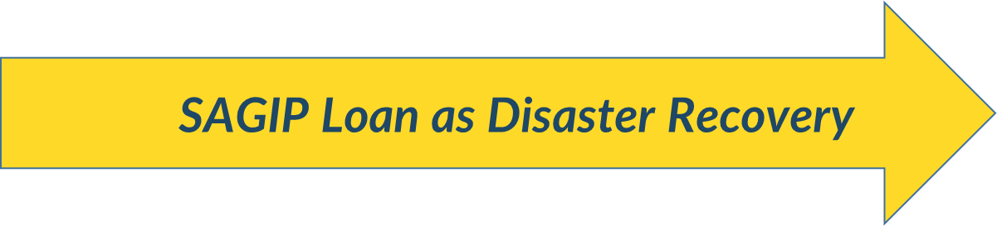


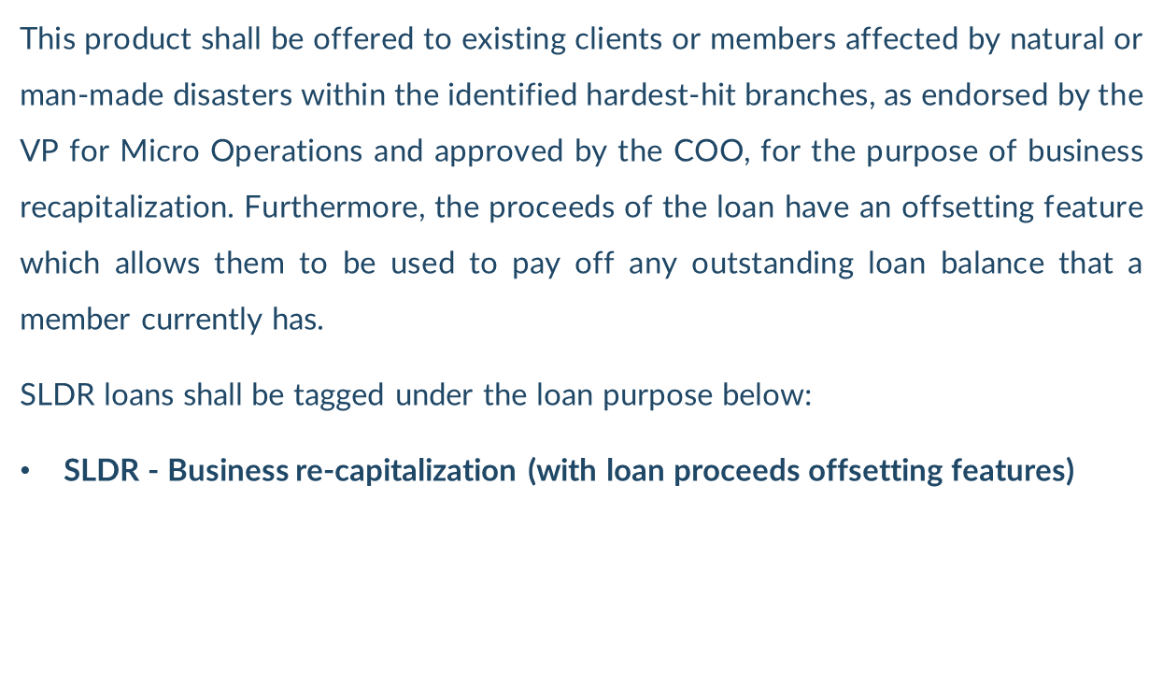

Slide 27
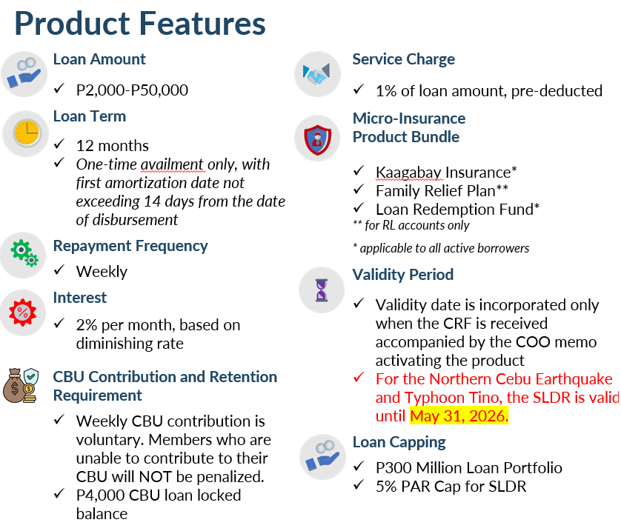
Product Features
Notes:
Eligibility Criteria
Intended for all RAFI Microfinance, Inc members of the specifically identified hardest hit branches but may also be activated on-demand for other branches if endorsed by the VP for Operations and approved by the COO, in cases where a man-made or natural disaster affects the area.
Affected by the natural or manmade disaster who have an immediate need for emergency funds.
Must not have a combined amortization for the
consolidated loans greater than P1,500 per week (or its equivalent in their cash flow).
Must have a sufficient cash flow to cover the applied loan amount
Documentary Requirements
•Picture of the business that are partially/totally damaged
Note: All SLDR loans shall undergo CI2 conducted by the Branch Supervisor, endorsed by the Area Manager and approved by the District Head (via email).

Slide 28
RAFI MFI Financial Products and Services
Production Loan
Supplemental Loan
SAGIP Loan as Disaster Recovery
Microinsurance
Kabuhayan Hog
Education Loan
SAGIP Loan as Emergency
Loan Redemption Fund
Microsavings
MyIpon
Mauswagon Loan
Housing Improvement Loan
CBU
Family Relief Plan
Kaagabay (GPA)

Slide 29



Kaagabay GPA Insurance
Comprehensive Accident Insurance
 | Coverage
 | RAFI MFI Members and their Spouse/Parent and Legal dependents/Siblings​
 | Eligibility
 | All production loan active borrowers aged 18 to 75 years old and:​ Spouses, if married, or Parents, if single, aged 18 to 75 years old​ Legal dependents, if married, or Siblings, if single, aged 14 days to 21 years old​​​
 | Documentary Requirements
 | Upon Enrollment : Submitted and approved online Loan Application Upon Claim​ (see succeeding slides for detailed list)
 | Premium
 | 110.00 per month P120.00 per month (for MPlus)​
 | Payment Mode
 | Pre-deducted from loan amount​
 | Payment Frequency
 | One-time, upon loan availment
 | Grace Period
 | 60 days after loan maturity​
Provides comprehensive financial protection for the family in case of accidental injuries and death.​
Covers Primary member and dependents
BENEFIT TYPES
 | Due to Accident | Due to Any cause
Living benefit | Accidental Medical Reimbursement Weekly Indemnity Disablement and/or Dismemberment | Hospital income benefit
Death benefit | Burial Assistance (for 1st cycle only) Accidental Death | Burial Assistance (for 2nd cycle and up) Financial Assistance Child Educational Assistance

Slide 30
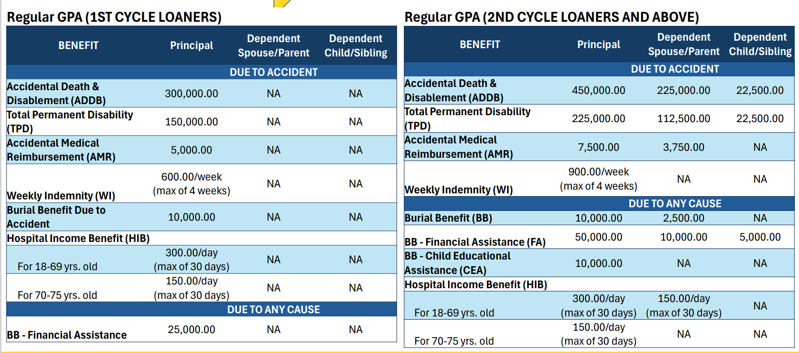
Kaagabay (GPA) Comprehensive Accident Insurance

Slide 31
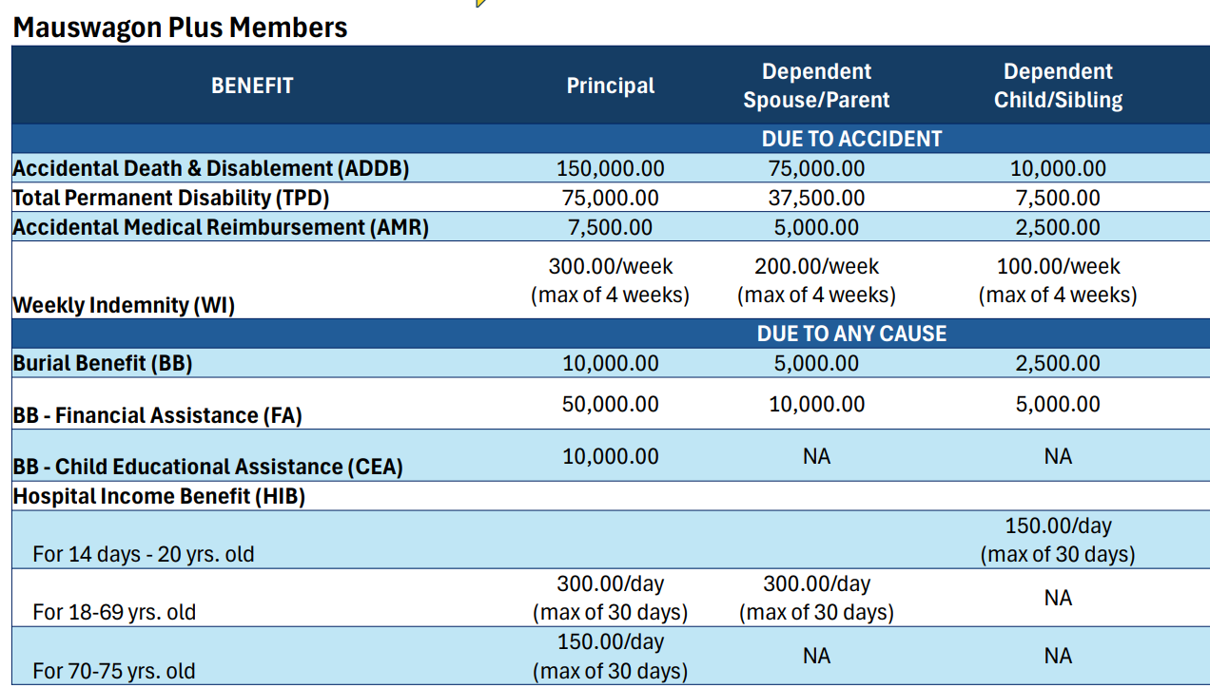
Kaagabay (GPA) Comprehensive Accident Insurance
Enhanced GPA for MPLUS

Slide 32
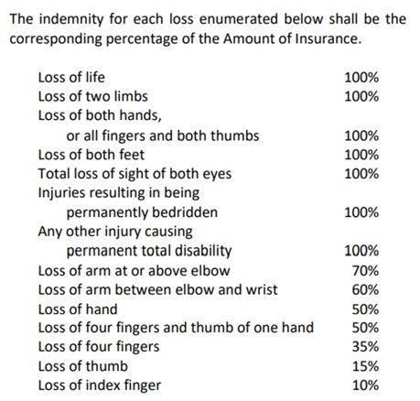
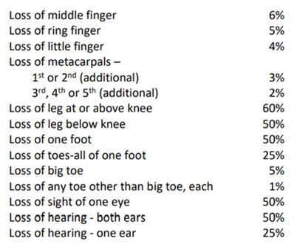
Kaagabay (GPA)
Scheduled % for TPD both for Regular Production Loans including Mauswagon Plus

Slide 33

Family Relief Plan(Burial (BURIAL ASSISTANCE)
 | Premium
 | 50.00/MONTH
 | Payment Mode
 | Pre-deducted from loan amount​
 | Payment Frequency
 | One-time, upon loan availment
 | Grace Period
 | No Grace Period
 | Coverage
 | RAFI MFI members
 | Eligibility
 | All production loan and SLDR Loan active borrowers with at least two (2) loan cycles aged 18 to 75 years old
 | Benefits to Clients
 | Provision of cash assistance on top of the existing death claim benefit​ Provision of additional groceries/ in kind pack to lessen burden for the household in time of grief​
Provides financial assistance for funeral and burial to alleviate the burden of the bereaved family in times of client’s death. Covers principal members only.
NOTE: The Provider shall not pay any death benefit if the member commits suicide within 6 months from the effective date or the date of the last reinstatement (if any) of his individual insurance coverage

Slide 34

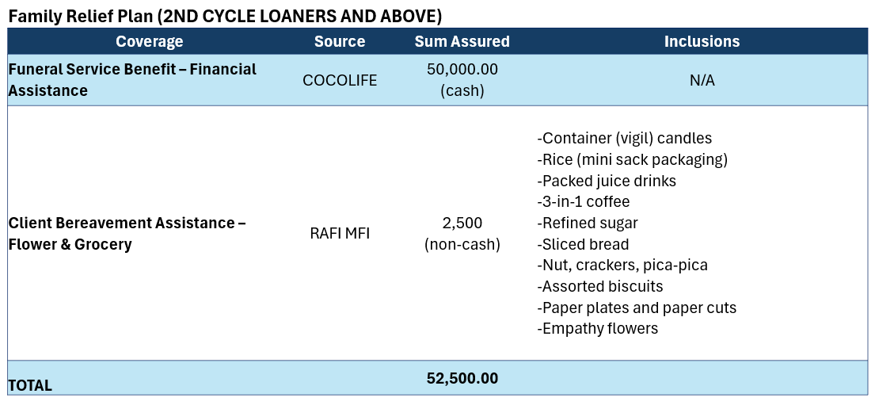

Slide 35

Loan Redemption Fund
 | Premium
 | 2% of loan amount, per annum, pro-rated per loan term​
 | Payment Mode
 | Pre-deducted from loan amount​
 | Payment Frequency
 | One-time, upon loan availment
 | Grace Period
 | No Grace Period
 | Coverage
 | Active loans of RAFI MFI borrower with benefit of total principal amount​​
 | Eligibility
 | All RAFI MFI active borrowers aged 18 to 75 years old
 | Documentary Requirements
 | Upon Enrollment​ Loan Application Form​ Upon Claim​ üNotice of Claim Form üInsurance Checklist üDeath Certificate (registered to MCR/LCR) üLoan Application (active) üLoan Ledger (updated) üPolice Blotter (if cause of death is due to accident) Interview Questionnaire (for 1st Cycle Loaner
A mandatory micro-insurance product which provides financial coverage to liabilities in the event of death so liability will no longer be transferred to the next of kin.​
​

Slide 36
RAFI MFI Financial Products and Services
Production Loan
Supplemental Loan
SAGIP Loan as Disaster Recovery
Microinsurance
Kabuhayan Hog
Education Loan
SAGIP Loan as Emergency
Loan Redemption Fund
Microsavings
MyIpon
Mauswagon Loan
Housing Improvement Loan
CBU
Family Relief Plan
Kaagabay (GPA)

Slide 37

Capital Build-Up (CBU)
A savings product aiming to help clients to develop the habit of savings with the intent of generating equity for their entrepreneurial endeavors and establish reserves for their bridge financing needs. This is a mandatory savings that can also help establish credit-worthiness of the client. ​
Unique Selling Proposition
Helps develop the culture of savings
May help clients weather credit shocks
May help clients avail of other ancillary products that RAFI MFI can offer

Slide 38




Product Features
 | Opening and Deposit Requirement
 | P50.00 upfront put up for other loans P50.00 per period for weekly Auto repayment shall be implemented to selected branches
 | CBU Retention Requirement
 | P4,000 of the total aggregate loan amount (Production + Supplemental) *with auto repayment implementation 20% of the total aggregate loan amount *with auto repayment implementation
 | Dormancy Period
 | 2 years or 730 days
 | Dormancy Fee
 | P30.00 per month** **Collection of Dormancy Fee will start on the 5th year or 61st month.
 | Eligibility
 | All RAFI MFI members
 | Interest on Savings
 | 0% (CBU-W) MICRO 4% per annum (CBU-Bi-M, CBU-M)MPLUS
 | Documentary Requirements
 | Upon Application: Loan Application online Promissory Note Client's ID Disclosure Statement and Amortization Schedule
 | Resters
 | 3 months
 | Maintaining Balance
 | Php 100
 | Maintenance Fee
 | P10 per month deducted after a 3-month period of inactivity for CBU balances below P100 P50 per month deducted after 360 days of inactivity for CBU balances ≥ P100

Slide 39
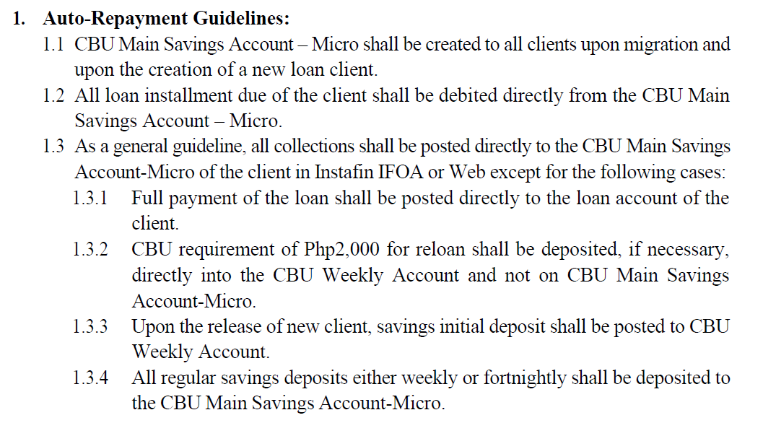

Slide 40
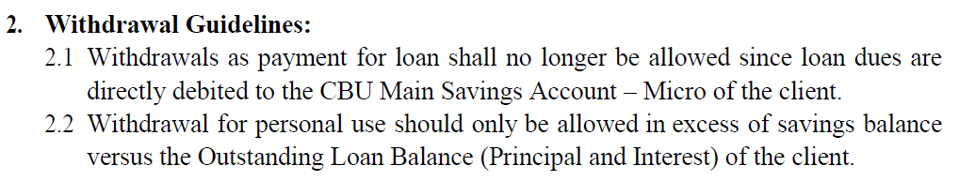
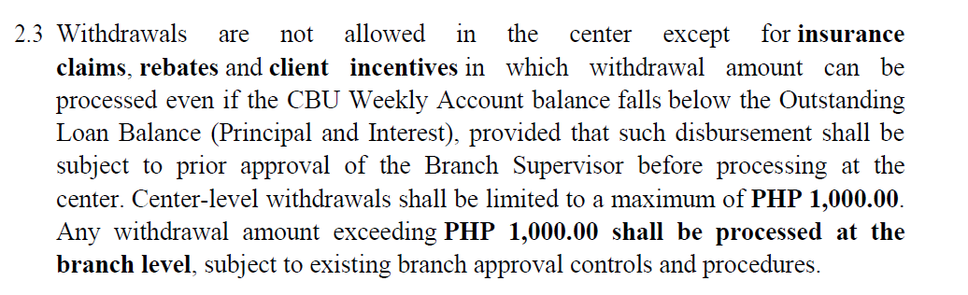

Slide 41
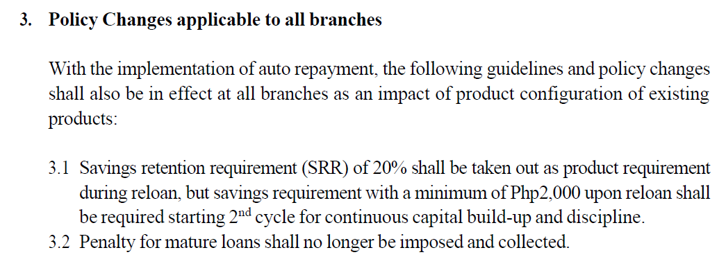

Slide 42

MyIpon Savings
A voluntary savings product on top of the CBU tied to a supplemental loan that offers higher interest for client financial empowerment by providing protection in the event of financial emergency leading to a greater sense of financial freedom and literacy.
Unique Selling Proposition
An investment product that earns a higher interest rate compared to other financial institutions
Boasts of an instantly activated savings facility that is easy to access with less requirements​
Promotes savings habit and discipline in order to support the client in times of emergencies (calamities, rainy days), family expense purpose (retirement, education) and in enabling the build- up of funds for business. ​
Opportunity to save on stable financial institution through RAFI MFI​
Opportunity to avail of other ancillary products that RAFI MFI has on its product menu​
Greater risk protection and financial freedom through an additional savings account

Slide 43


Product Features
 | Opening and Deposit Requirement
 | MyIpon – minimum of P5.00 (however, clients are encouraged to deposit more than the minimum amount)
 | Minimum Balance to Earn Interest
 | P500.00
 | Compounding Schedule
 | Monthly
 | Posting Schedule
 | Quarterly
 | Interest on Savings
 | 6% per annum
 | Resters
 | 3 months (maintenance fee: P10.00 per month after a 3-month period of inactivity)
 | Maintaining Balance 100.00
 | Dormancy Period
 | 2 years or 730 days
 | Dormancy Fee
 | P30.00 per month
 | Eligibility
 | All RAFI MFI​​ active Supplemental Loan borrowers on top of their CBU account (only clients without PAR are entitled to interest compounding)​​
 | Final Withholding Tax
 | 20% on MyIpon interest earned by clients
 | Documentary Requirements
 | Upon Application​ Passbook Payment for MyIpon account**​ Upon Withdrawal​ A duly filled-out and signed withdrawal slip*​
*Obtained from branches ​**Obtained from clients

Slide 44

SAGIP Loan as Disaster Recovery
(Social Assistance Geared for Indigent People Loan)
This product shall be offered to existing clients/ members who have an immediate need for emergency funds as a results of a natural or manmade disaster within twelve (12) months where such disaster impacted the branch for 30% or more of its member base’s houses or livelihood through the following purposes:
SLDR - Hospital/medical fees | SLDR - Fishing boat and/or implements acquisition
SLDR - Purchase of medicines | SLDR - Fishing boat repair
SLDR - Facilities remediation and maintenance
SLDR - Business re-capitalization (with loan proceeds offsetting features)

Slide 45
Salamat!

